Slide 1
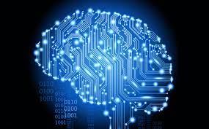
Sudoku Solver using Deep Learning and Computer Vision
Date : 29th Jan 2023
Made by : Sahil Wani
II Yr. Electrical Eng.
IIT Bombay

Slide 2
PROJECT OVERVIEW
Image
Pre-Processing
Digit Recognition Model
Input Image
Sudoku Solving Algorithm
Overlaying Solution
OUTPUT
Github Link for the source code of this project

Slide 3
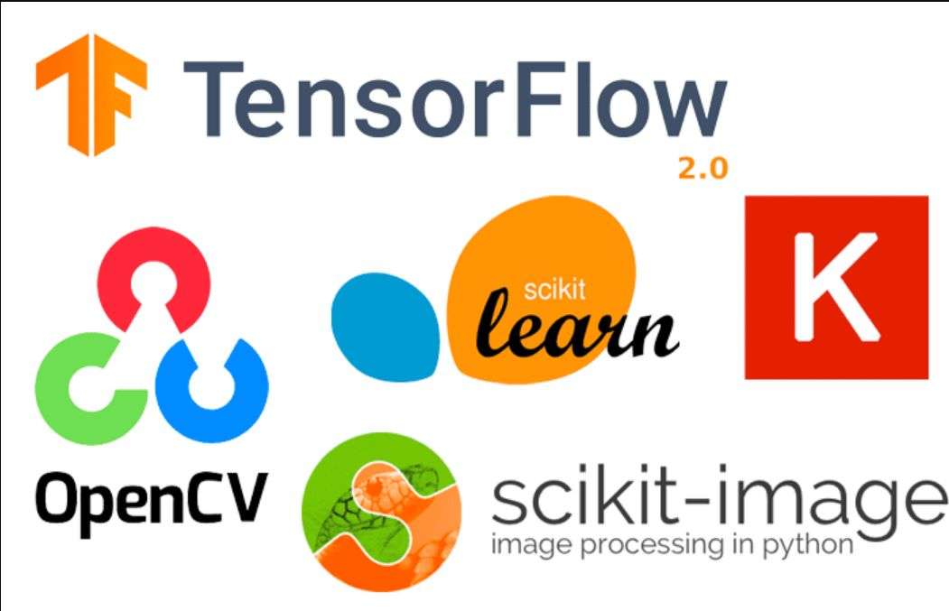

Technologies Used

Slide 4
Image Pre-Processing
Reading the Image : This has been done with the help of cv2.imread() function from OpenCV.
Extracting the board : Perspective Transformation and contour detection functions from opencv library have been employed for this purpose.
Splitting of the board : The board is splitted into 81 cells. hsplit() and vsplit() from numpy have been used for this.

Slide 5
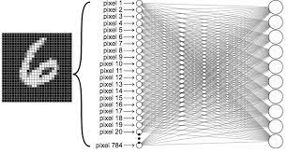
Digit Recognition Model
A Deep Neural Network Model is trained using a standard digits dataset.
It is then deployed to predict the digits from the splitted sudoku cell images, giving a predicted digits array.

Slide 6
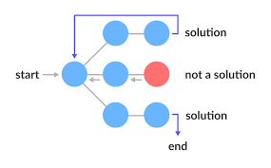
Sudoku Solving Algorithm
The predicted digits array is then solved using an algorithm known as Backtracking.
In simple words, the algorithm searches for every possible combinational solution to the problem, but at the same time, rejects a candidate solution as soon as it is unable to fit certain basic criterion.

Slide 7
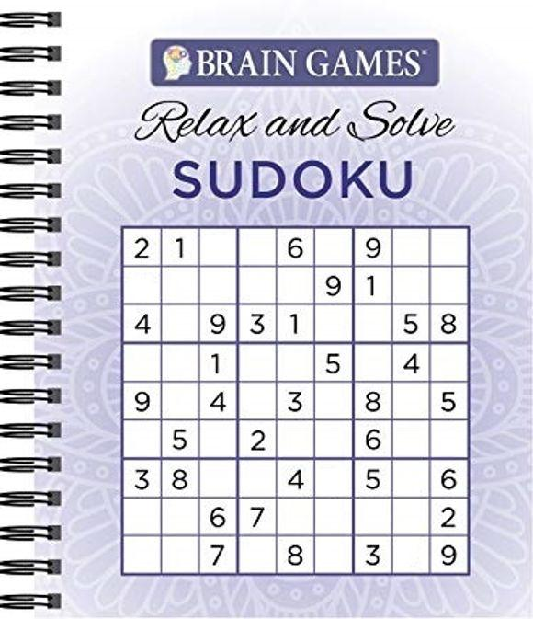
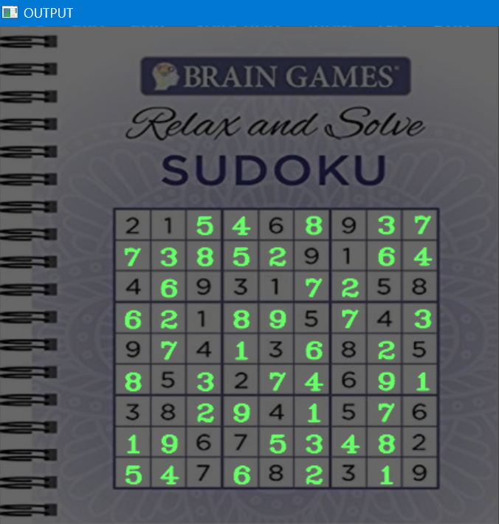
Overlaying the Solution
Using cv2.putText() and Inverse Warp Perspective methods from OpenCV, the solution is overlaid on the Input Image.
The background brightness is reduced to highlight the solved digits.

Slide 8
References
Click here : Backtracking Algorithm
Click here : Deep Learning and Neural Networks
Click here : OpenCV Tutorial
This project has been a part of the Winter in Data Science (WiDS) Program conducted by Analytics Club, IIT Bombay
Mentors : Harsh Chaurasia, Tanisha Jain
Disclaimer : This is a very basic level implementation of the idea, having scope for a ton of optimizations and improvements, which have not been considered due to lack of time. References have been taken from various resources available on the Internet in the making of this project.

Slide 9
Further Scope for Improvements
In future versions of this project, I look forward to implement the following ideas and functionalities :
Solving in Real-Time : You capture the image of the sudoku puzzle using your camera. In real-time, the program will form a solution for you and will overlay the solution over the clicked picture.
Optimizing the Algorithm : There are several more efficient algorithms (eg. Greedy Best First Search) which can be implement in place of Backtracking.
Improving Model Performance : A better trained OCR Model (eg. cloud-based OCR APIs) will decrease the possibility of the program giving incorrect solutions or throwing errors.

